Slide 1

AUTOMATIC ATTENDANCE SYSTEM USING FACE RECOGNITION
Submitted by:
Dharshik G.S 2018504523
Sairushan A 2018504596
Sathiya Murthi S 2018504604
Reviewed By:
Dr. A.Viji

Slide 2
Contents
A brief look at what we will discuss on this report
Abstract
Objective
Requirements
Block Diagram
Methodology
Inference
Conclusion
References

Slide 3
Abstract
A facial recognition system is a technology capable of matching a human face from a digital image or a video frame against a database of faces, typically employed to authenticate users through ID verification services, works by pinpointing and measuring facial features from a given image. Although the accuracy of facial recognition systems as biometric technology is lower than iris recognition and fingerprint recognition, it is widely adopted due to its contactless process and this is very favourable during this pandemic situation.

Slide 4
Objective
To set up a contactless automatic attendance system using face recognition that can be easily deployed and implemented.
This would help in
Eliminating chances of false attendance and missed entries
Cheaper alternative to fingerprint authentication
Ease of automation made available to Teachers and Employers
Implementation option in online classes and sessions

Slide 5
Requirements
Software:
Python
MTCNN Face Recognition Library
FaceNet by Keras
TensorFlow
OpenCV
For hardware implementation:
Raspberry Pi
Pi camera / Supported Camera
Enclosure
Server, Database

Slide 6

Block Diagram
Training phase
Collect images
Face Recognition
Cropping of face
Embeddings using FaceNet

Slide 7
Block Diagram
Testing
Test image loaded
Export attendance
Faces in image identified
Identified
Embeddings extraction
Compared with database

Slide 8
Block Diagram
Face Recognition
Original Image
P-Net
Bounding Boxes
R-Net
Bounding Boxes
O-Net
Bounding Boxes and
landmarks

Slide 9

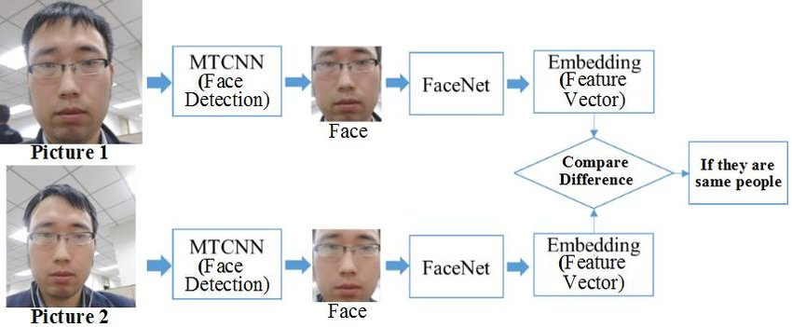
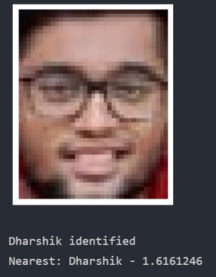
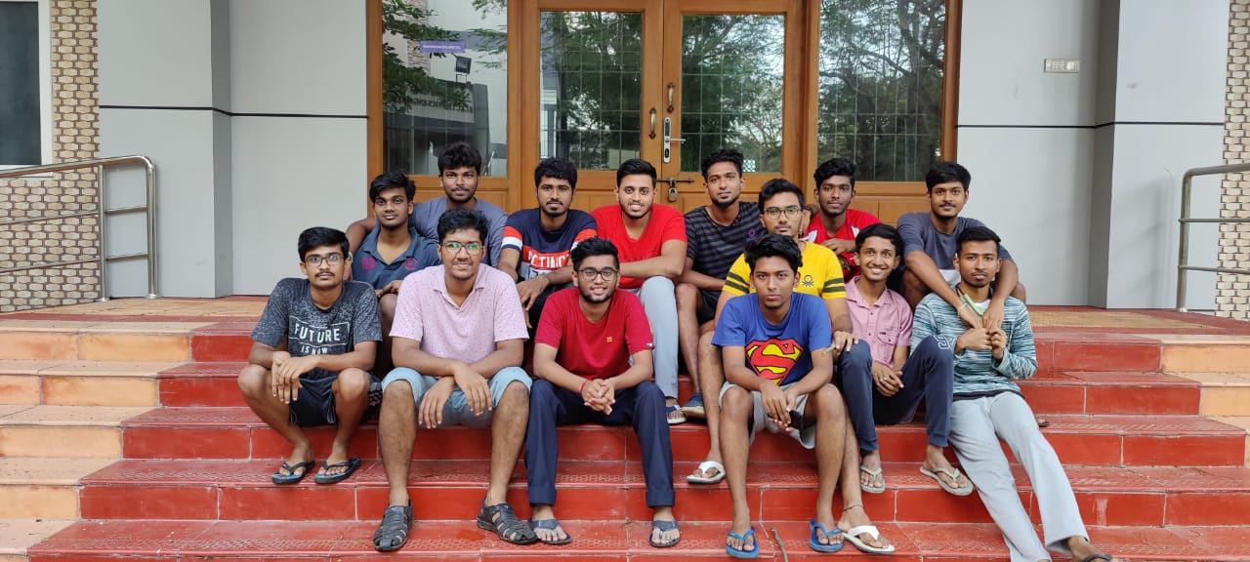
Block Diagram
Testing

Slide 10
Methodology
Training
Collect images
Face Recognition using MTCNN
Cropping of face
Embeddings using FaceNet
Testing
Test image loaded
Images in face identified
Embeddings extracted for test image faces
Compared with database for similarity
Identified
Export attendance by validation of members in the image

Slide 11
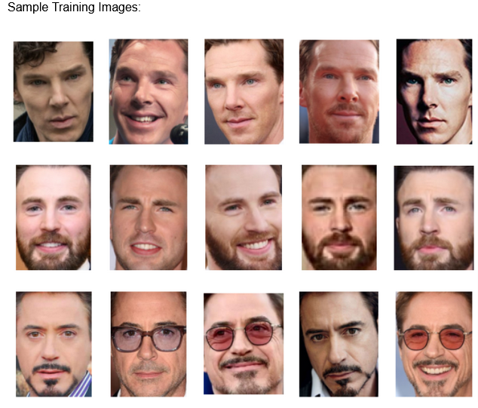
Inference

Slide 12
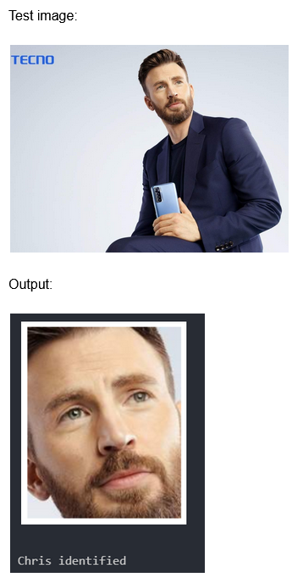
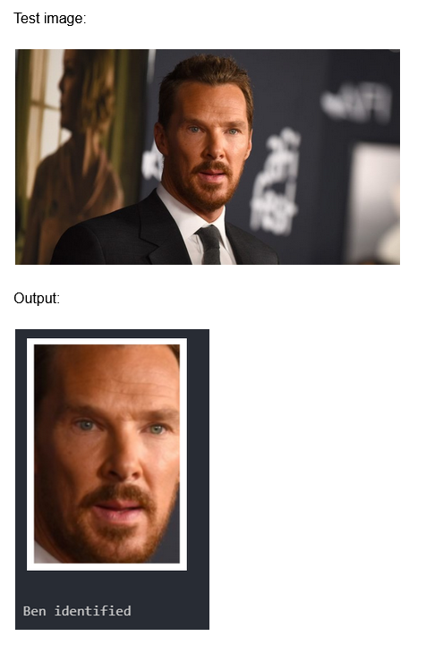
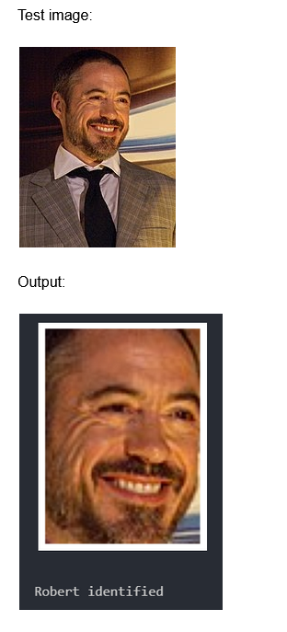
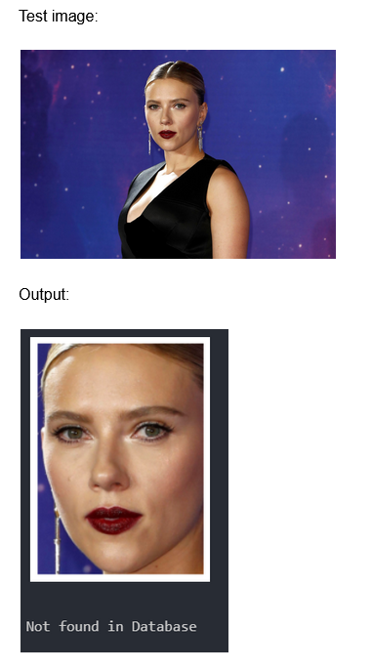
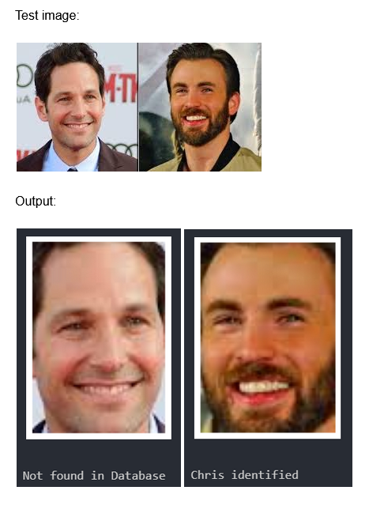
Inference

Slide 13
Conclusion
Thus we can see that the python script can perform facial recognition and detection which is in turn implemented for attendance validation. Test images have been used to estimate its performance and the script has been able to correctly identify the users as expected by using embeddings extracted by FaceNet.
The above algorithm can either be loaded onto a microprocessor like Raspberry Pi for onboard processing or can be loaded to a remote server that can fetch the images from a classroom’s CCTV footage to do the processing off-board. It can also be implemented as an Android app that can be used by Teachers and Employers to maintain attendance.

Slide 14
Conclusion
Implementation was also tested using a Raspberry Pi wherein the Pi was made to upload an image captured by an attached web camera to a cloud database and then this image was fetched by a computer system acting as a server for testing purposes and by running the script, attendance logging was validated.
Thus we have implemented an Automatic Attendance System using Face Recognition in Python.
GitHub link: https://github.com/sam189239/face_attendance

Slide 15
References
https://en.wikipedia.org/wiki/Python_(programming_language)
https://medium.com/@iselagradilla94/multi-task-cascaded-convolutional-networks-mtcnn-for-face-detection-and-facial-landmark-alignment-7c21e8007923
https://www.geeksforgeeks.org/facenet-using-facial-recognition-system/
https://en.wikipedia.org/wiki/OpenCV

Slide 16
End of Report

